Slide 1

Designing a Digital Portfolio
By Afsana Parveen F (BCA – IInd Year) M.M.E.S. Women's Arts and Science College

Slide 2

Introduction
This project aims to introduce you to the fundamentals of digital portfolios—what they are, why they matter, and how you can build one yourself. It's designed especially for those who are new to digital portfolios or have never created one before. This presentation will serve as a helpful starting point to guide you through the essentials and get you moving forward confidently.

Slide 3

Understanding Digital Portfolios
Digital portfolios can take many forms, such as personal websites displaying graphic design work, online galleries for photographers, digital writing collections for authors, or interactive resumes highlighting professional achievements.

Slide 4

Why should students have a Digital Portfolio?
Showcases skills and achievements
Demonstrates professional growth
Supports job applications and interviews
Provides a centralized collection of work
Enhances personal branding and online presence

Slide 5

An example - Digital Portfolio
Problem Statement: Students often struggle to showcase their projects in an organized way. A digital portfolio helps them present work, skills, and achievements professionally.
Project Overview: This portfolio is a web-based platform to display academic projects, coding skills, and achievements in an interactive format.

Slide 6

An example - Digital Portfolio
End Users: Students, job seekers, teachers, and recruiters can use the digital portfolio to share or review projects and skills. What you want your viewers to understand about you.
Tools and Technologies: HTML, CSS, JavaScript for the front-end; PowerPoint, Canva/ Figma for design; GitHub Pages for hosting.

Slide 7
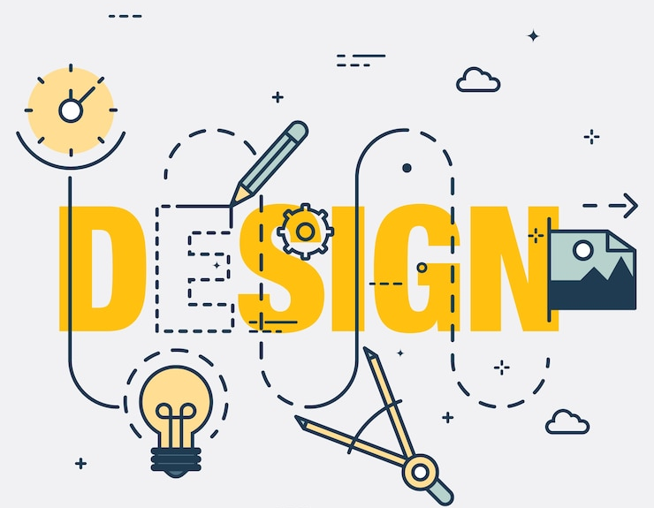
An example - Digital Portfolio
Portfolio Design and Layout: The portfolio with a profile photo, personal details, achievements, skills, experience and a clean card-based project or professional gallery.
Features and functions: - Responsive design (works on mobile & desktop) - Clickable project cards with descriptions - Contact form to connect with the owner

Slide 8
An example - Digital Portfolio
Result and Screenshot: - Achievements - Skills - Education - Interest - Language - Personal detail

Slide 9
Final Thoughts
As we wrap up this presentation, remember that embarking on the journey to build the own digital portfolio is a deeply personal venture. It reflects an identity, an achievements, an aspirations, and the future envision.
The digital portfolio helps present projects professionally, improves visibility, and increases chances of academic and job opportunities.

